Slide 1

Zomato Data Analysis
(Mini Project)
Tejas Sawant.
© All rights reserved by Fireblaze Technologies Pvt. Ltd.

Slide 2
Problem Statement
1.Number of Restaurant of different countries ?
2.Calculating of total Rating text Overall and New Delhi ?
3.Top five best rating restaurant ?
4.How many Table book , online line delivery ,of top country and top city the given data?
© All rights reserved by Fireblaze Technologies Pvt. Ltd.

Slide 3
Proposed Solution
By using python like matplotib and Seaborn we will perform data visualization on given dataset and try to find useful insights.
© All rights reserved by Fireblaze Technologies Pvt. Ltd.

Slide 4
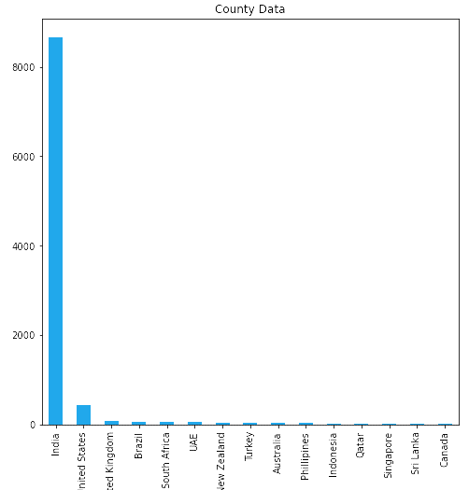
Data Analysis
Restaurant Count per city.
Number of restaurant in different countries
INDIA and UAS
© All rights reserved by Fireblaze Technologies Pvt. Ltd.

Slide 5
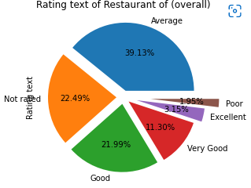
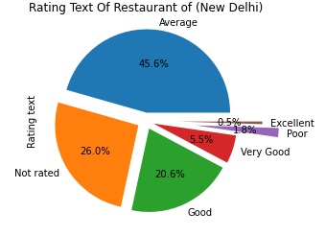
Data Visualization
Rating text of restaurant
© All rights reserved by Fireblaze Technologies Pvt. Ltd.

Slide 6
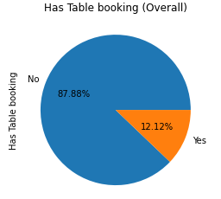
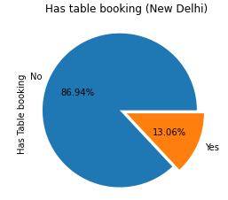
Data Visualization
Has Table booking
© All rights reserved by Fireblaze Technologies Pvt. Ltd.

Slide 7
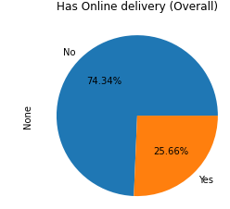
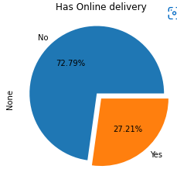
Data Visualization
Online Delivery
© All rights reserved by Fireblaze Technologies Pvt. Ltd.

Slide 8
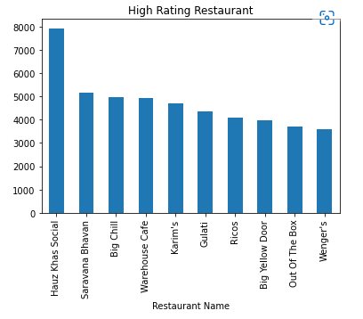
Data Visualization
Top 5 High Rating restaurant in (New Delhi)
© All rights reserved by Fireblaze Technologies Pvt. Ltd.

Slide 9
Disadvantage
India Single Oriented Data.(90%)
We cannot get much insight on other countries.
© All rights reserved by Fireblaze Technologies Pvt. Ltd.

Slide 10
ADVANTAGES
Zomato is start in India.
Insight about country wise distribution of restaurants.
Price range analysis country wise.
Rating text analysis country wise as well as New Delhi.
Online delivery status analysis country wise as well as New Delhi.
Has Table booking analysis country wise as well as New Delhi.
© All rights reserved by Fireblaze Technologies Pvt. Ltd.

Slide 11
Conclusion
Price range in India is good around mean value of overall world.
Most of the customer base of zomato is concentrated around regions surrounding in New Delhi.
72% restaurants in India has not available online delivery services.
86% restaurants in India has not table booking.
© All rights reserved by Fireblaze Technologies Pvt. Ltd.

Slide 12
Future Scope
Restaurants should be encouraged to go online this platform.
Data captured should be efficiently used for both customer and zomato.
Company need to focus on collaboration with restaurants in order to expand business.
© All rights reserved by Fireblaze Technologies Pvt. Ltd.

